Slide 1
Employee Data Analysis using Excel
1
STUDENT NAME:R.PRAVIN RAJ
REGISTER NO:312218465
DEPARTMENT:BACHELOR OF COMMERCE
NAAN MUDHALVAN USER NAME:E3D37646F948516BE654056E1765AC3C
COLLEGE:GOVERNMENT ARTS AND SCIENCE COLLEGE PERUMBAKKAM

Slide 2
PROJECT TITLE
Employee Performance Analysis using Excel
2

Slide 3
3
AGENDA
Problem Statement
Project Overview
End Users
Our Solution and Proposition
Dataset Description
Modelling Approach
Results and Discussion
Conclusion

Slide 4

PROBLEM STATEMENT
Inaccurate performance evaluation:
Current manual methods of evaluation often lead to subjective
Judgments and inconsistencies, impacting employee morale and organisational and productivity.
Lack of data driven insights:
Without a structured approach to data collection and
Analysis, organisation struggle to identify trends, areas for improvement, and
Effective performance strategies.

Slide 5

PROJECT OVERVIEW
I sourced an employee dataset from the EDUNET website, applied color coding to relevant topics, and removed blank cells using conditional formatting and filters. Employee ratings were converted from numerical to verbal categories using a formula. A pivot table was then created with business units as rows, performance levels as columns, and first names as count values, with gender code as a filter. A slicer was used to filter data by employee type, and a graph was generated from the filtered data with appropriate titles.

Slide 6

WHO ARE THE END USERS?
Human Resources (HR) Professionals
Managers
Employees
Executives
External Stakeholders (e.g., Investors, Shareholders)
Training and development teams
Supervisor
Recruitment teams

Slide 7

OUR SOLUTION AND ITS VALUE PROPOSITION
Filter- Remove blanks
Conditional formatting- Missing values
Graph- Visualization
Pivot table- Analysis
Slicer- Filtering

Slide 8
Dataset Description
8
Employee id
Employee first name
Employee last name
Employee classification type
Gender code
Current employee performance
Business unit
Employee type
Performance level.

Slide 9

THE "WOW" IN OUR SOLUTION
9
{=IFS(Z8>=5,"VERY HIGH,"Z8>=4,"HIGH,"Z8>=3,"MED,"TRUE,"LOW")}
For converting the current employee rating numerical values into verbal format.
3/21/2024 Annual Review
9

Slide 10
MODELLING
10
1. Data Source:
- Dataset was sourced from the EDUNET website.
2. Data Preparation:
- Applied color coding to highlight topics relevant to the analysis.
- Used conditional formatting and filter options to remove blank cells.
3. Data Transformation:
- Converted numerical employee rating values into verbal categories using the formula:
excel
=IFS(Z8>=5,"VERY HIGH",Z8>=4,"HIGH",Z8>=3,"MED",TRUE,"LOW")
- Applied this formula to all employees.
10

Slide 11
11
4. Data Analysis: - Selected necessary data fields for creating a pivot table.
- Row Values: Business units.
- Column Values: Employee performance level.
- Count Values: Employee first name.
- Filter Options: Gender code.
- Used a slicer to filter data based on different employee types.
5.Data Visualization:
Created a graph from the filtered data.
Provided appropriate titles for the graph and its axes.

Slide 12
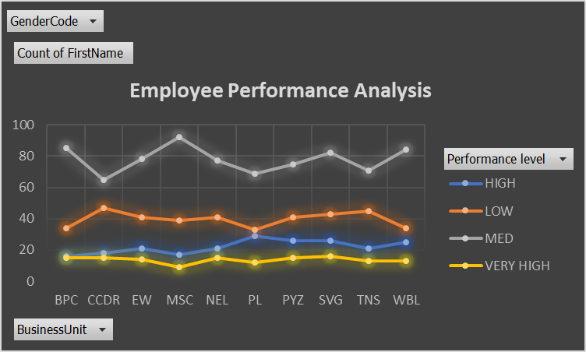
RESULTS
12
12

Slide 13
CONCLUSION
13
Improve performance: Identify high-performing employees, areas for improvement, and training needs.
Enhance decision-making: Make informed decisions about hiring, promotions, and compensation.
Optimize HR processes: Streamline recruitment, onboarding, and performance management.
Foster employee engagement: Identify factors affecting employee satisfaction and engagement.
Reduce turnover: Analyze reasons for employee departures and implement retention strategies.

